Slide 1


LINGAYA’S VIDYAPEETH
Faridabad, Haryana
Deemed-to-be-University u/s 3 of UGC Act 1956
NAAC Accredited, Approved by MHRD/ AICTE/ PCI/ BCI/ COA/ NCTE

Slide 2
Introduction to FPGA: Hands-On with Intel development board DE2i-150 using Quartus & ModelSim
A Five Day Workshop
Jayaraj V S
Assistant professor
Department of ECE
Lingaya’s Vidyapeeth

Slide 3
Course content
DAY-1
Session-II
Introduction to Quartus II Software ,Installation and Licensing
Verilog Programming Basics
Introduction to DE2i-150 Board

Slide 4

Introduction to Quartus II Software
What is Quartus II Software?
Quartus II Software, was developed by Altera (now part of Intel), is a comprehensive integrated development environment (IDE) for designing Field-Programmable Gate Arrays (FPGAs) and Complex Programmable Logic Devices (CPLDs).
It provided tools for designing, simulating, testing, and programming these programmable logic devices.
Quartus II is widely used in industries and academia for its robustness, extensive device support, and integration with Intel FPGAs (formerly Altera FPGAs).

Slide 5
Key features of Quartus II
Design Entry: Support for various design entry methods such as schematics, Hardware Description Languages (HDLs) like Verilog and VHDL, and block diagrams.
Design Synthesis: Converting the design description into a netlist of logic gates and other elements suitable for FPGA
implementation.
Simulation: Verifying the functionality of the design through simulation before synthesis and implementation on hardware.
Implementation: Placing and routing the design onto the actual FPGA or CPLD hardware, ensuring timing constraints
are met and optimizing resource usage.
Timing Analysis: Analyzing and optimizing the timing performance of the design to ensure reliable operation.
Programming: Generating programming files (such as .pof or .sof files) for configuring the FPGA or CPLD.
Debugging: Tools for debugging designs, including SignalTap II Logic Analyzer for real-time debugging of FPGA designs.

Slide 6
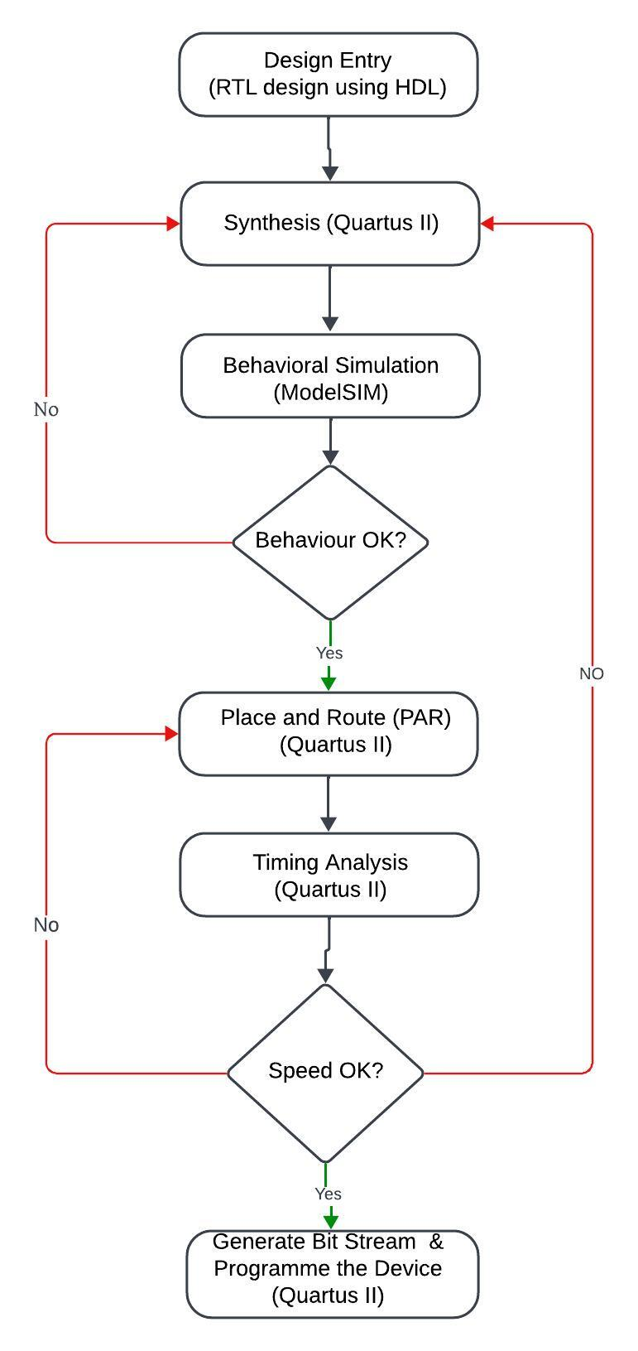
Quartus II Design flow for FPGAs

Slide 7
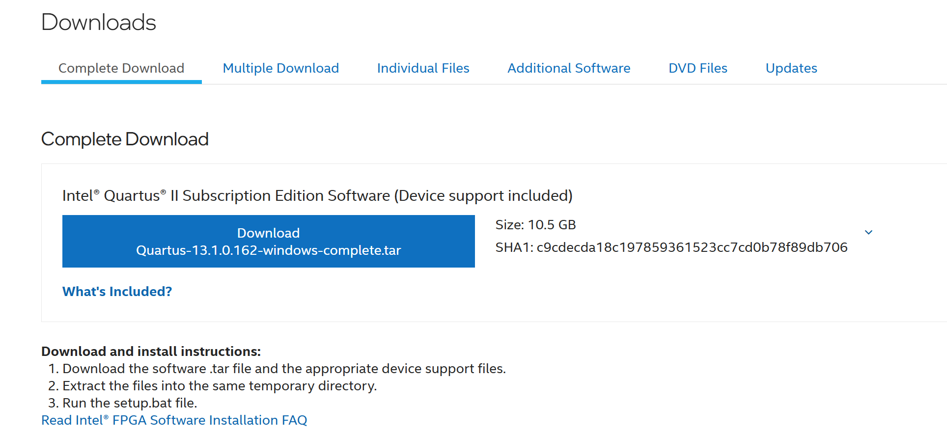
Quartus II Software Installation and Licensing
Visit the following site:Intel® Quartus® II Subscription Edition Design Software Version 13.1 for Windows
Now click to download and install after extraction

Slide 8
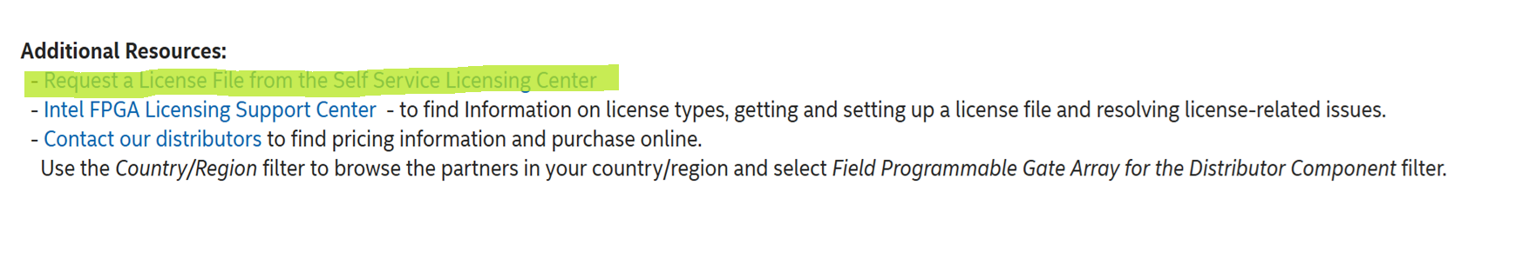
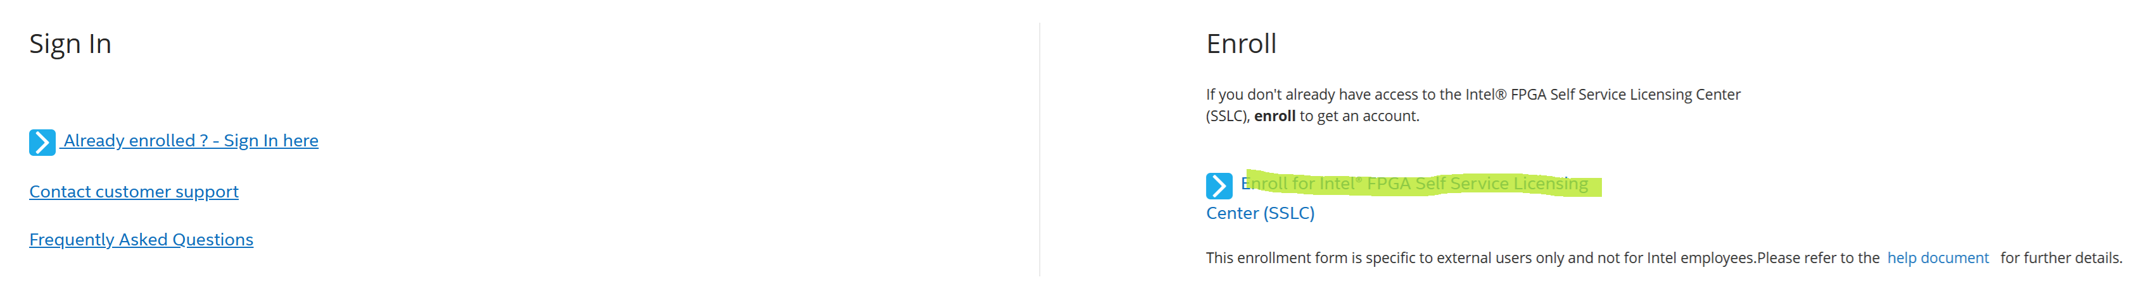
Quartus II Software Installation and Licensing
Now scroll down to Addition resources and click
This will enter : Home (intel.com) and click

Slide 9

Quartus II Software Installation and Licensing
Now fill up the form and click verify your email

Slide 10
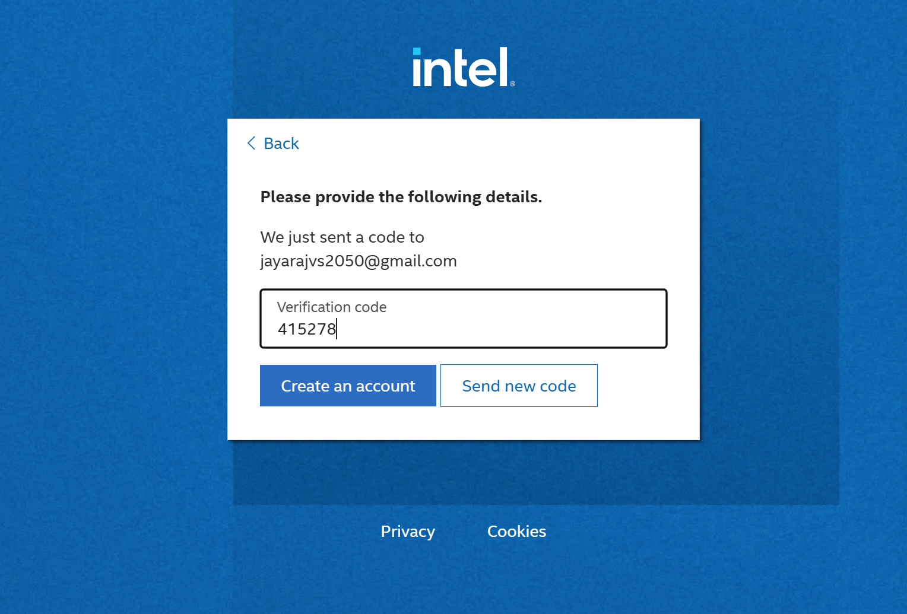
Quartus II Software Installation and Licensing
Now go to your registered email id and get the verification code and type here and click create an account

Slide 11
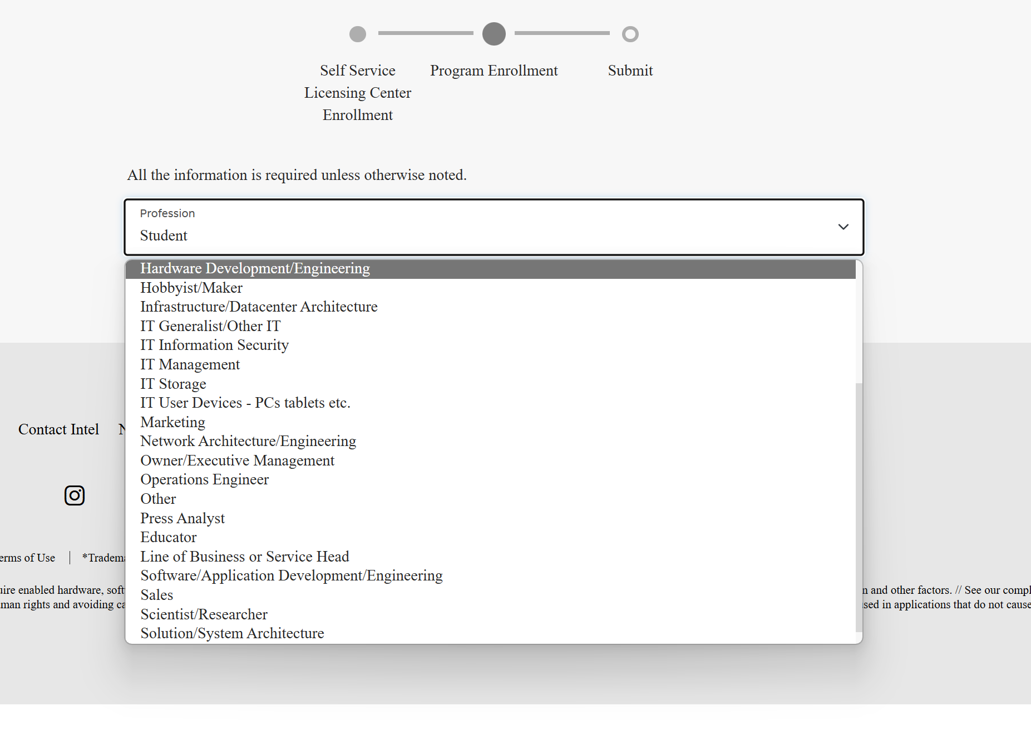
Quartus II Software Installation and Licensing
Now choose your profession as desired

Slide 12
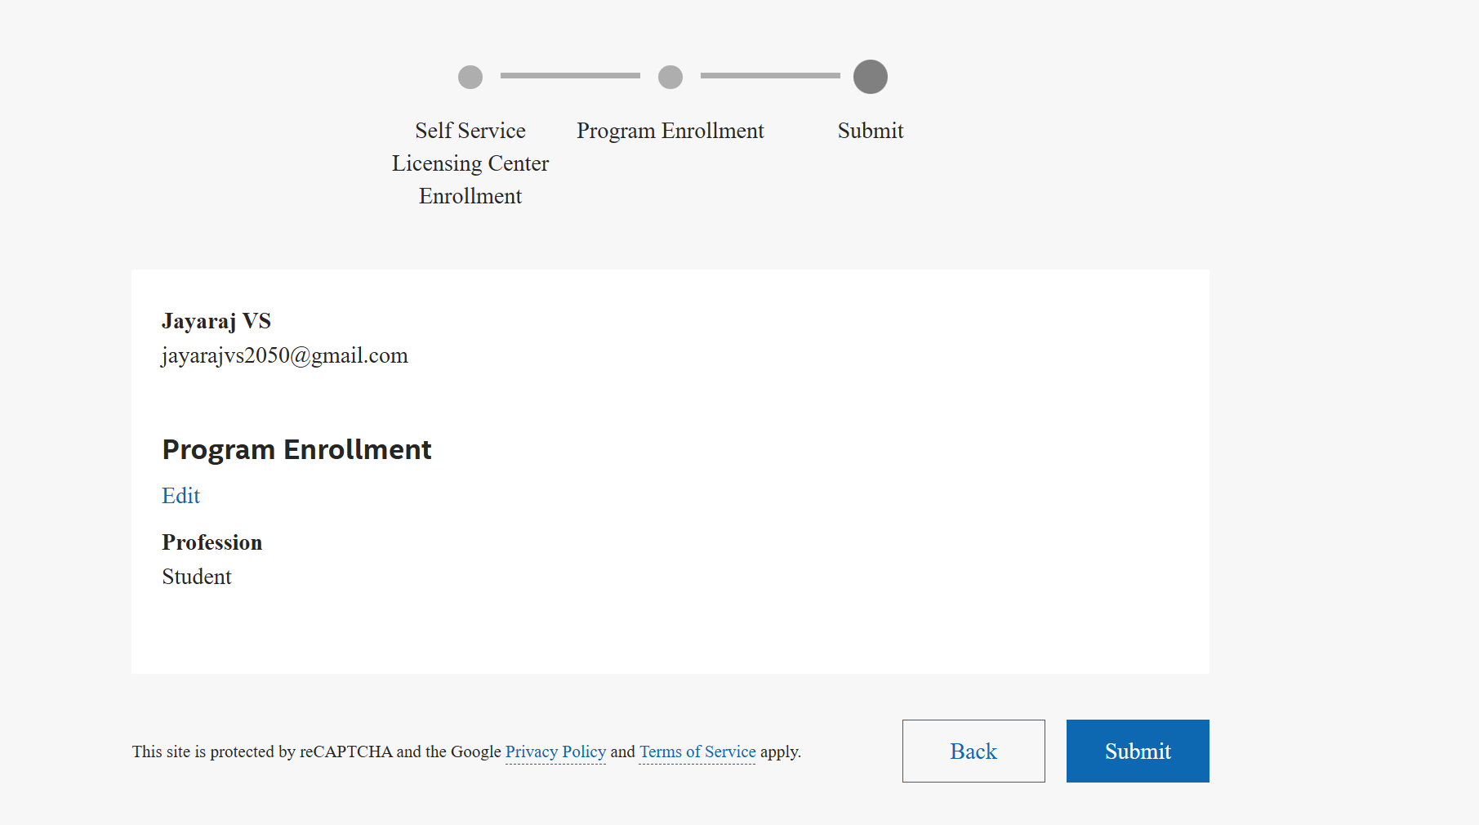
Quartus II Software Installation and Licensing
Now choose submit and wait…….

Slide 13
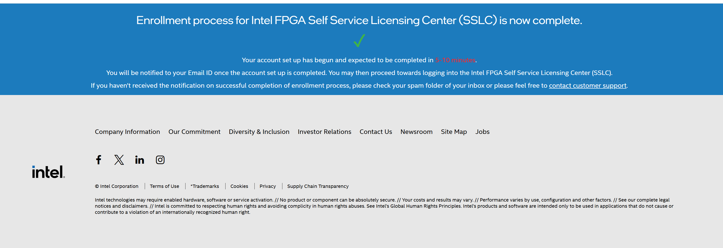
Quartus II Software Installation and Licensing

Slide 14
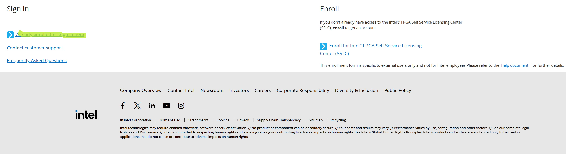
Getting Licensing for Quartus II
Now go back to :Home (intel.com) and click

Slide 15
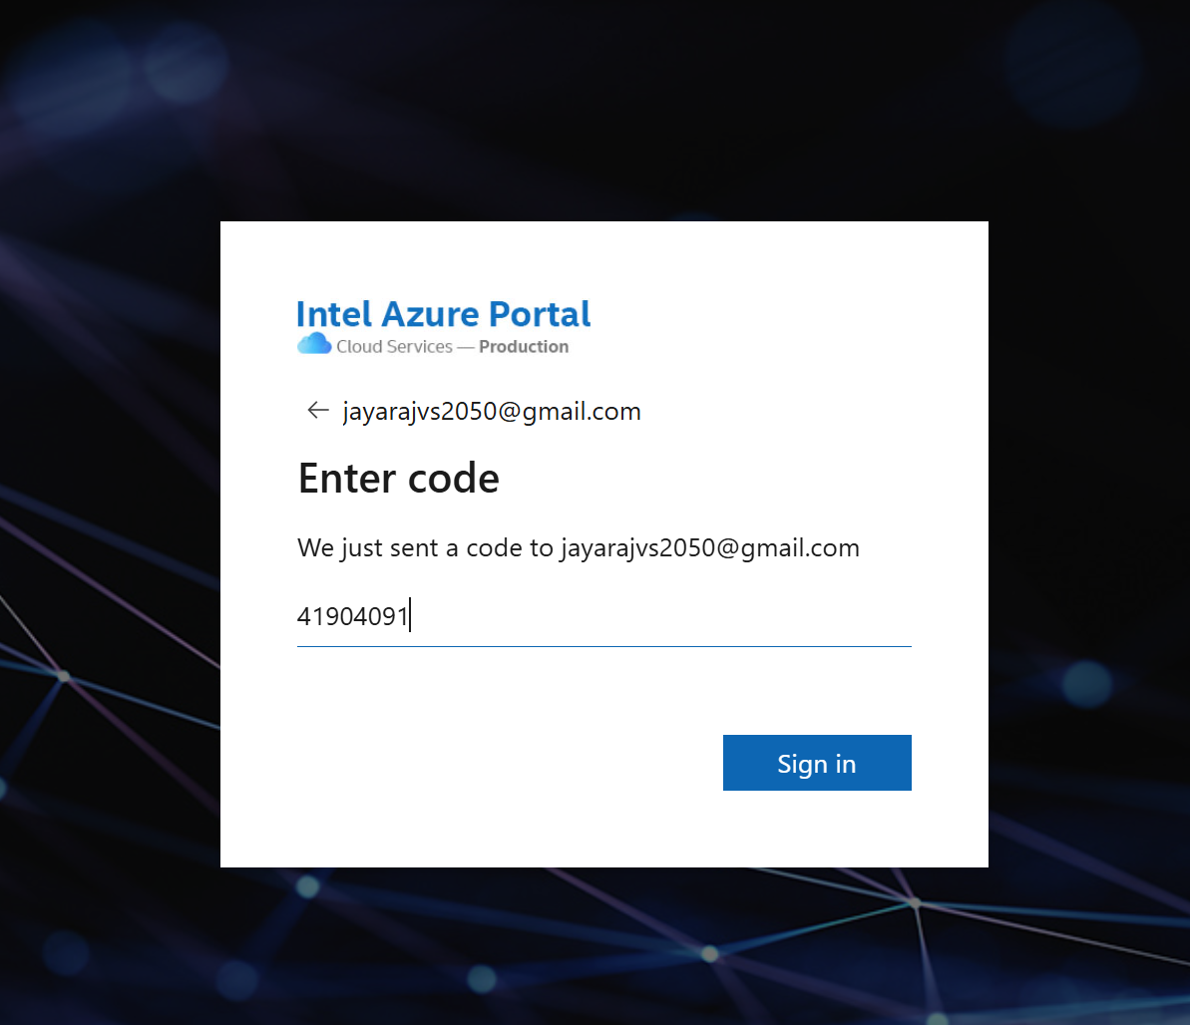

Getting Licensing for Quartus II
Now go back to your registered mail and copy the code , sign in and click accept

Slide 16
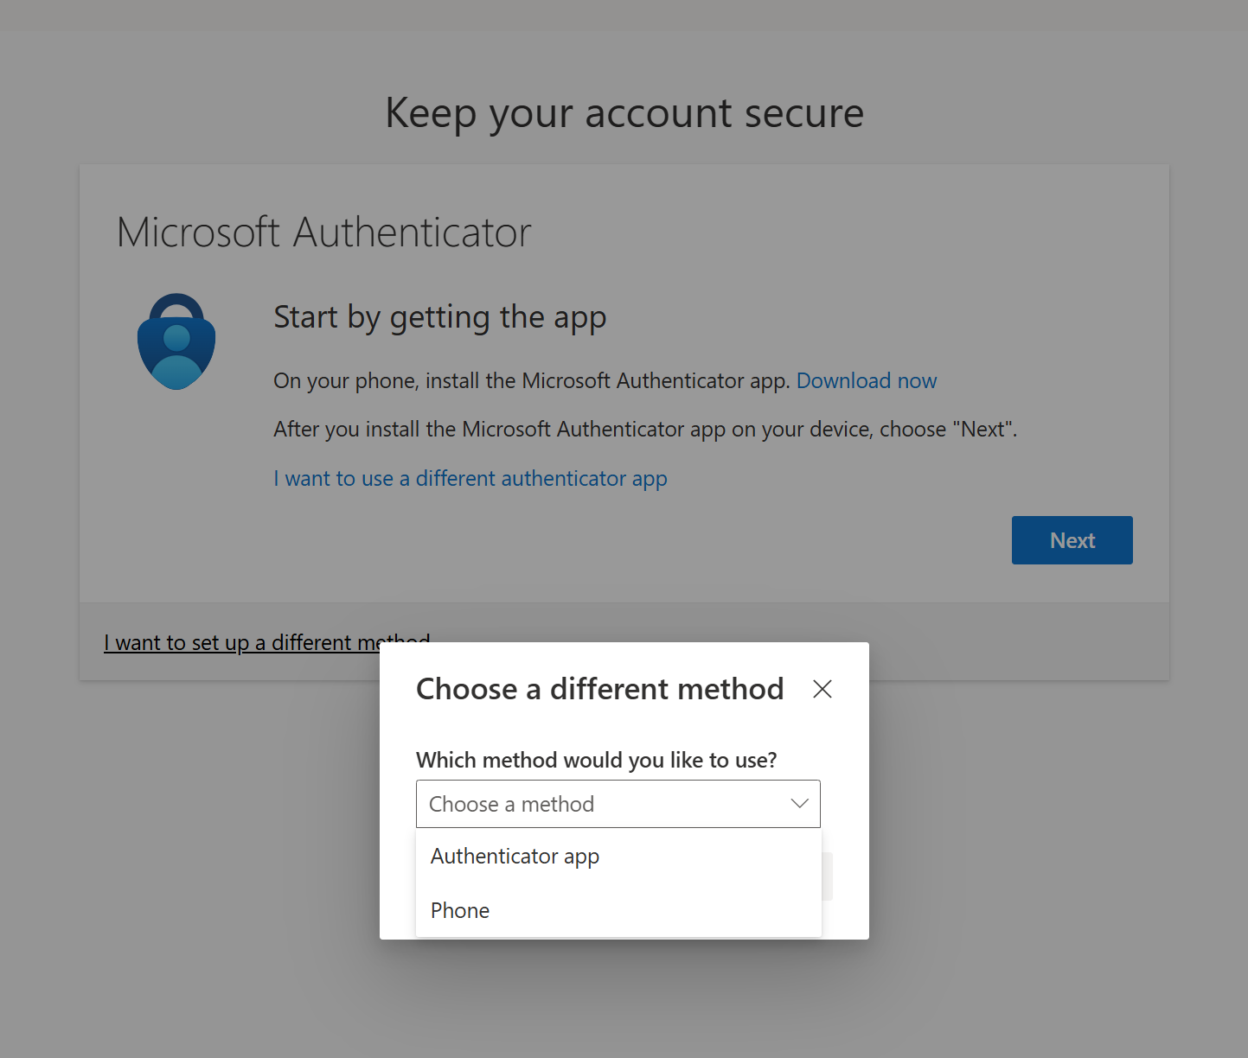
Getting Licensing for Quartus II
Next it will ask to install Microsoft authenticator (don’t go for it )
Choose a different method(phone) and choose confirm.

Slide 17
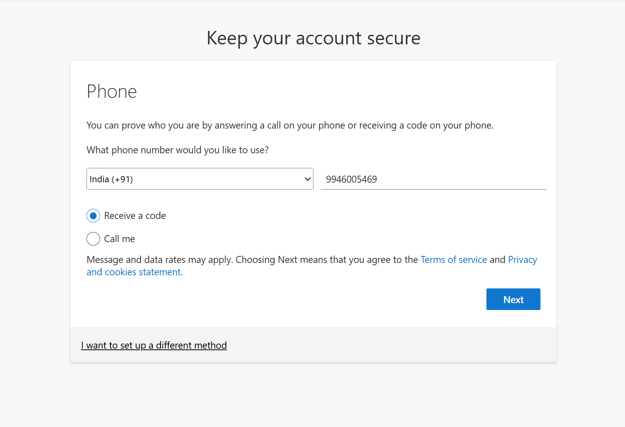
Getting Licensing for Quartus II
Now choose India and enter phone number and press next.

Slide 18
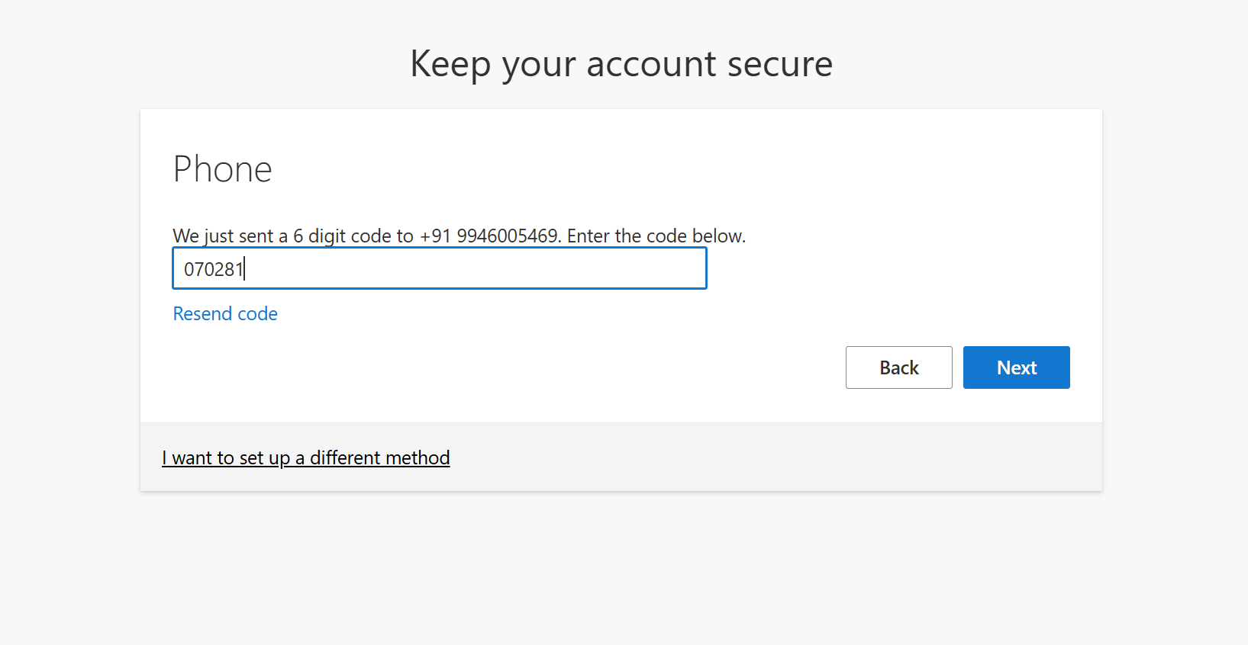
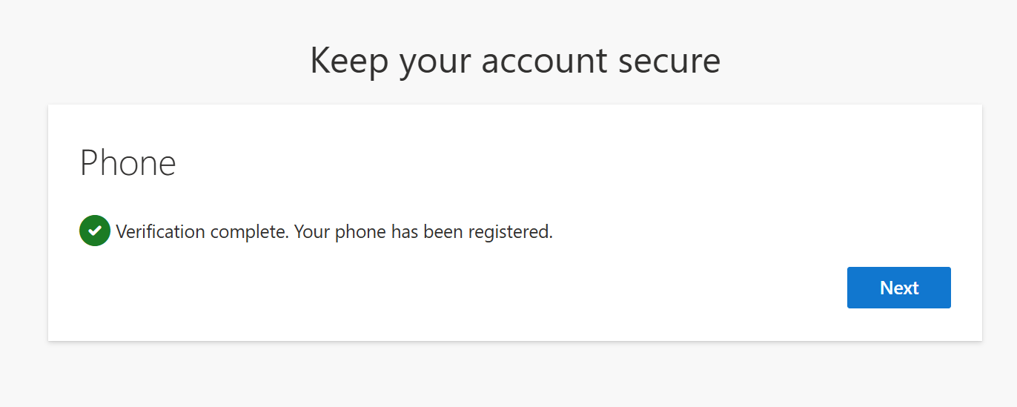
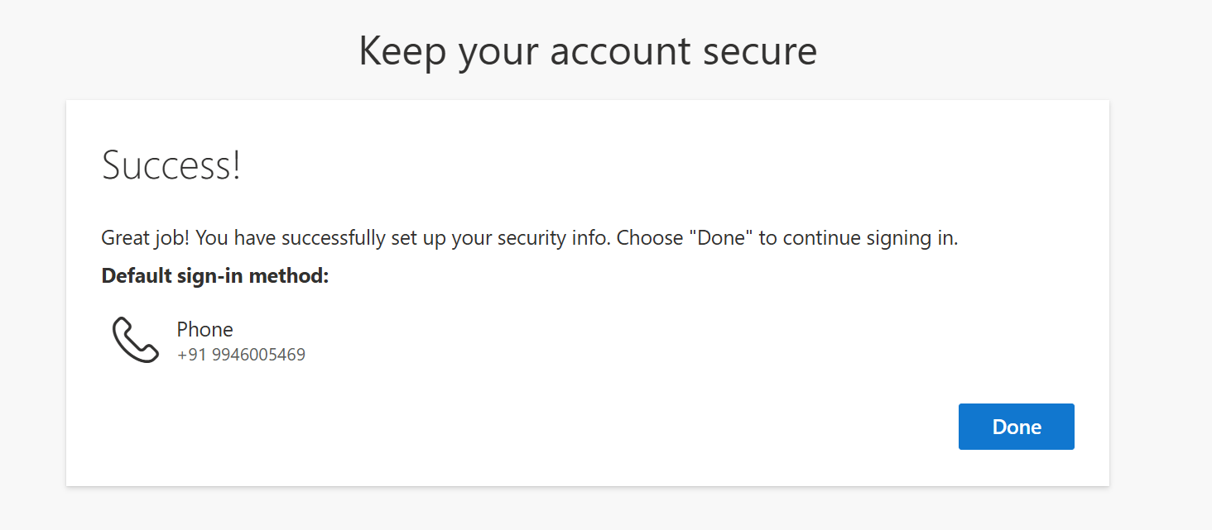
Getting Licensing for Quartus II
A verification code will be sent to your entered mobile number.
Enter the number here and click Next.
Again click Next.
Now press Done

Slide 19
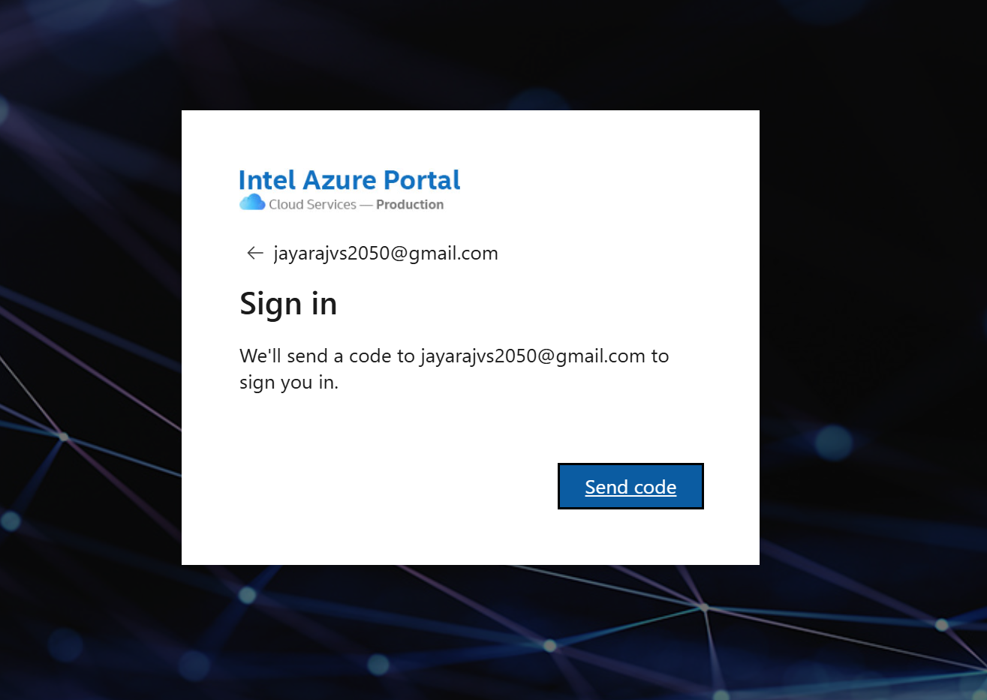
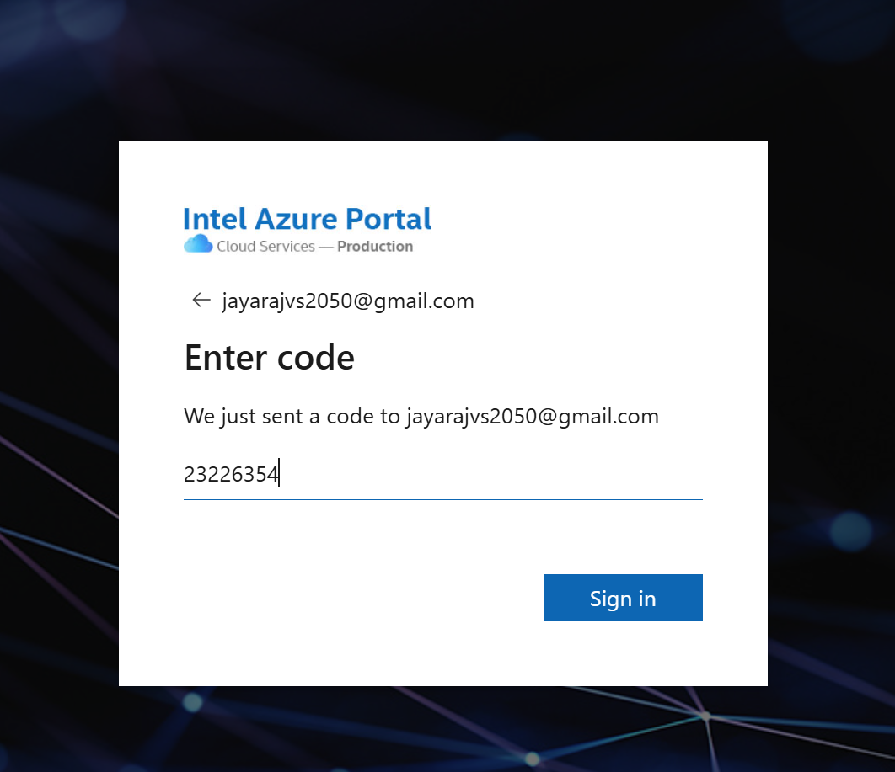
Getting Licensing for Quartus II
Press sent code .
Enter the code from mail and press Sign in.

Slide 20
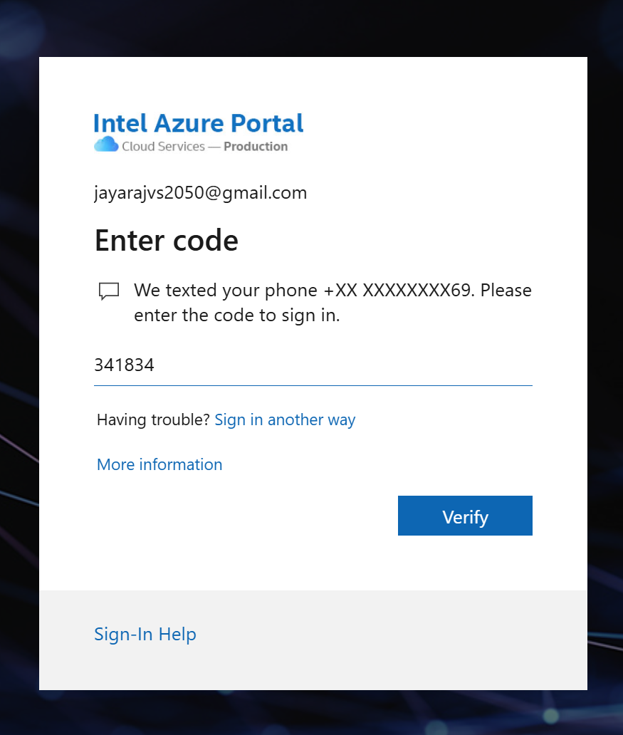
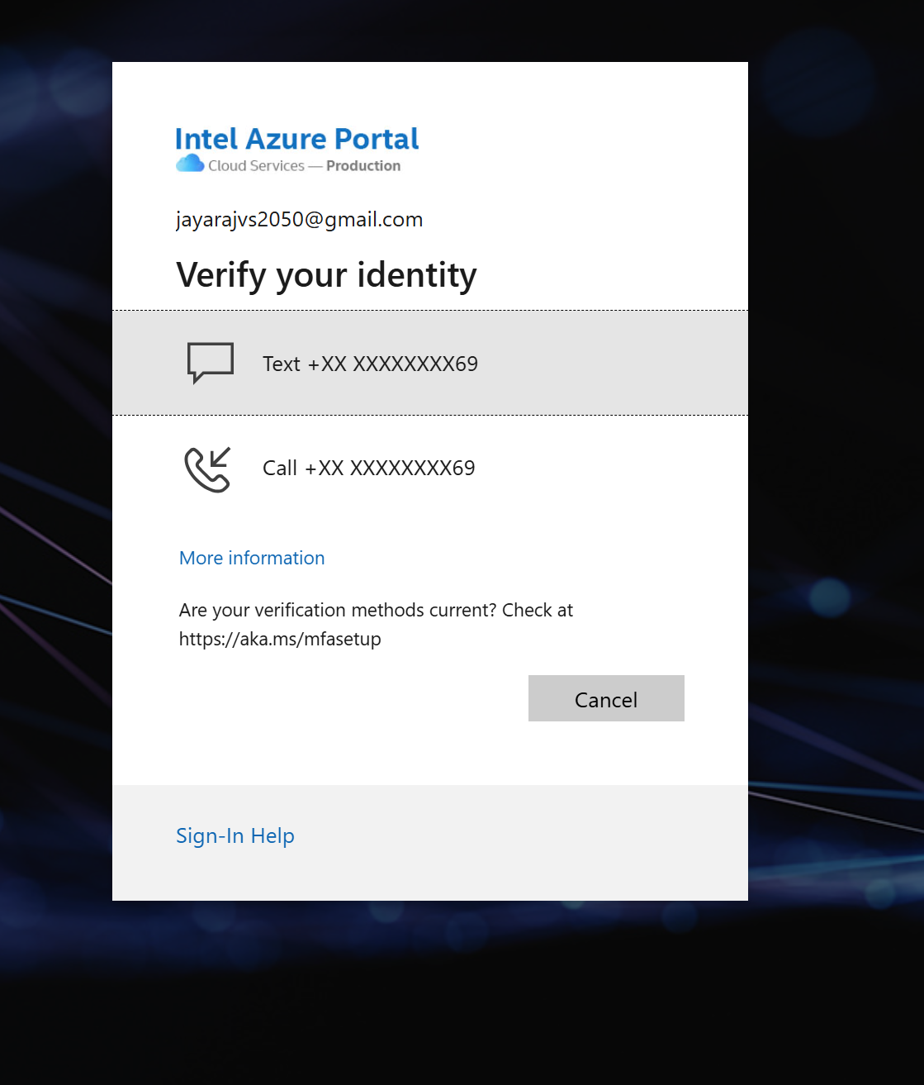
Getting Licensing for Quartus II
Press text.
Enter the code from phone and press verify.

Slide 21
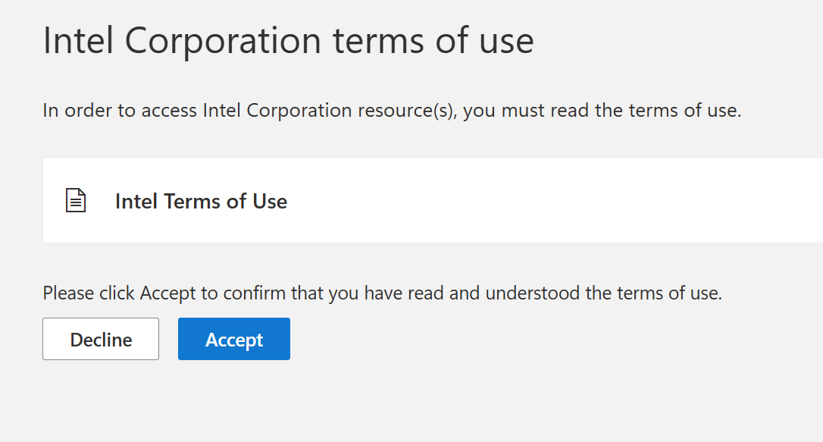
Getting Licensing for Quartus II
Press Accept.
Read the terms and submit.

Slide 22
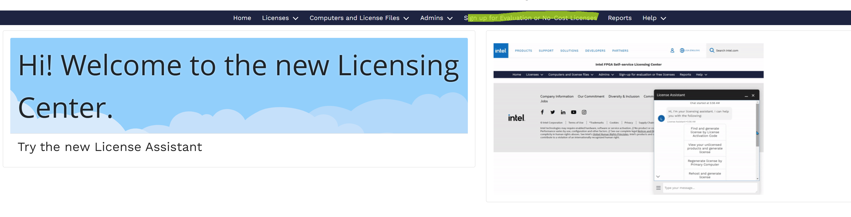
Getting Licensing for Quartus II
Now press Sign up for evaluation or no cost license.

Slide 23
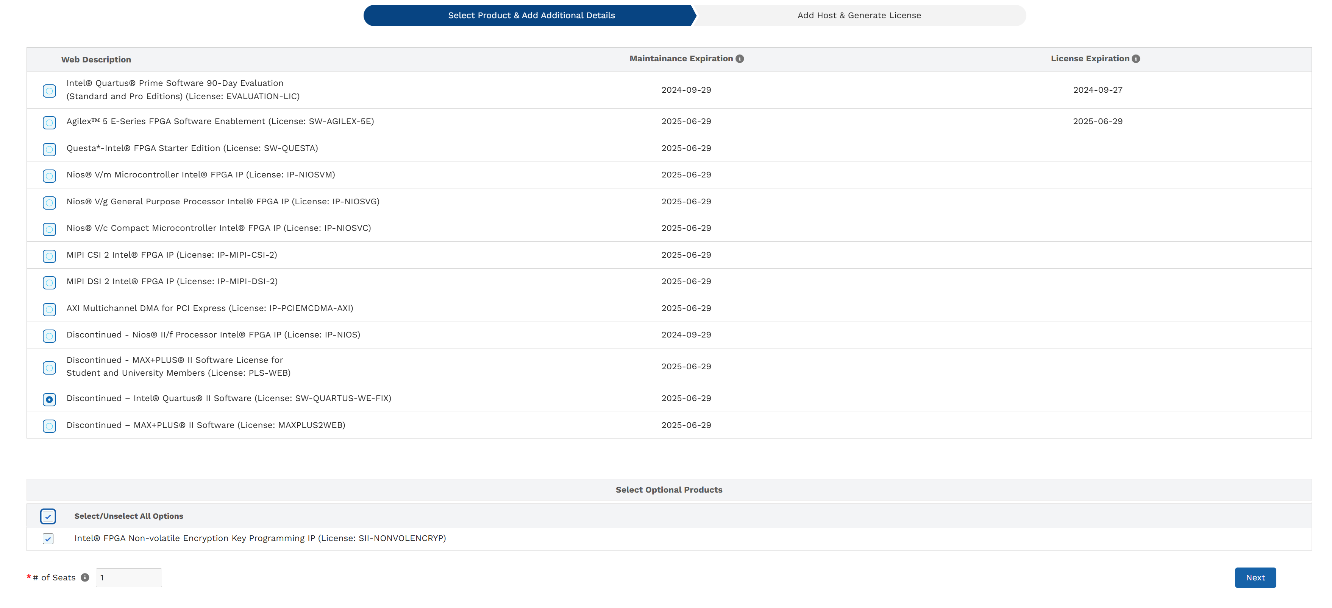
Getting Licensing for Quartus II
Now select discontinued Intel Quartus 2,tick mark both option and press next.

Slide 24
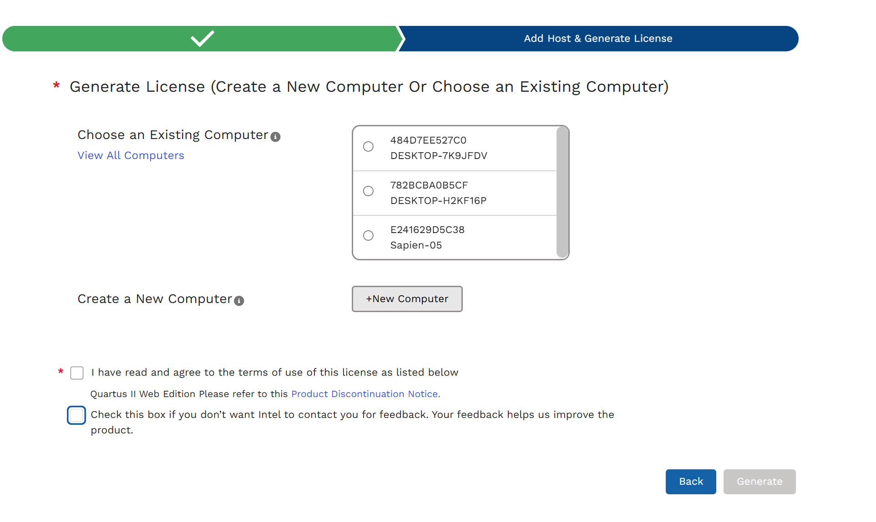
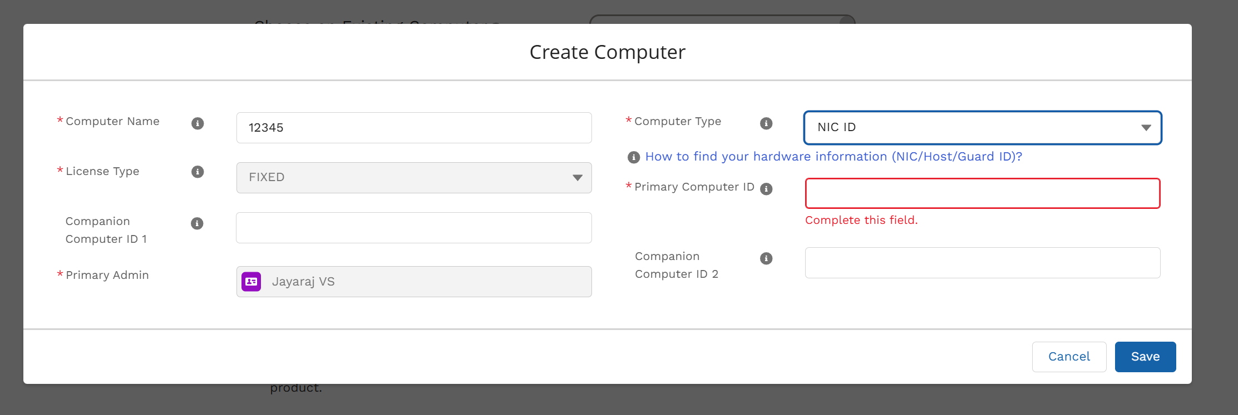
Getting Licensing for Quartus II
Now select New computer(for first time you will not see any list as in figure ).
Now enter your computer name and choose computer type as NIC ID.
To get NIC ID go to cmd window and type- ipconfig/all

Slide 25
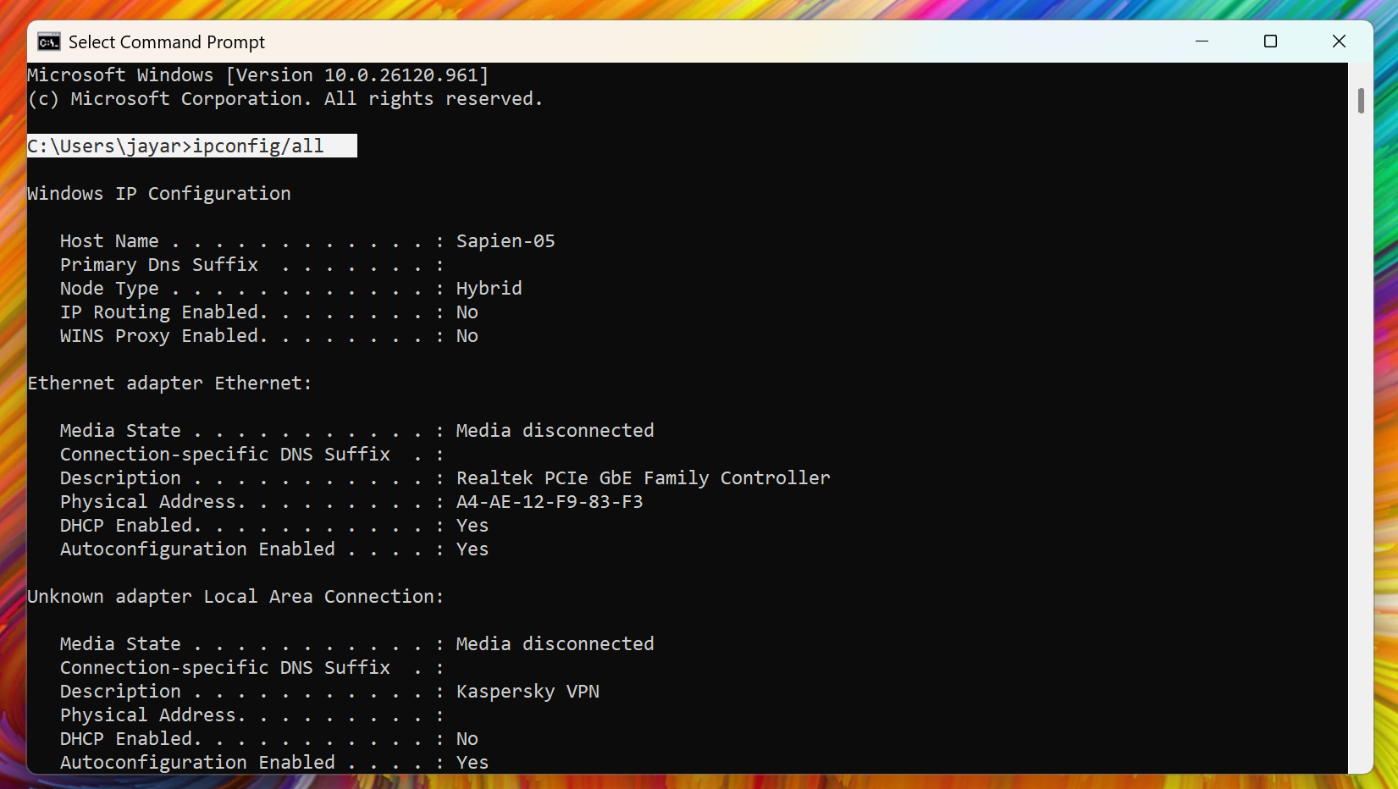
Getting Licensing for Quartus II
Now select New computer(for first time you will not see any list as in figure ).
Now enter yout computer name and choose computer type as NIC ID.
To get NIC ID go to cmd window and type- ipconfig/all

Slide 26
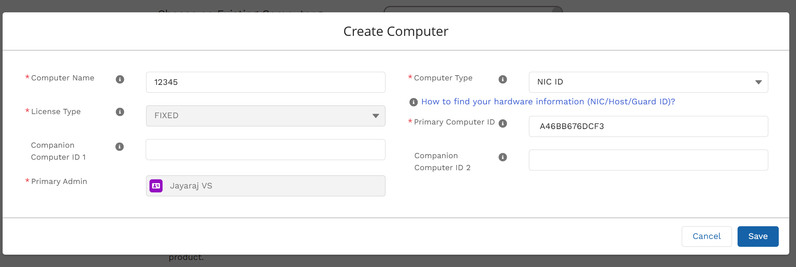
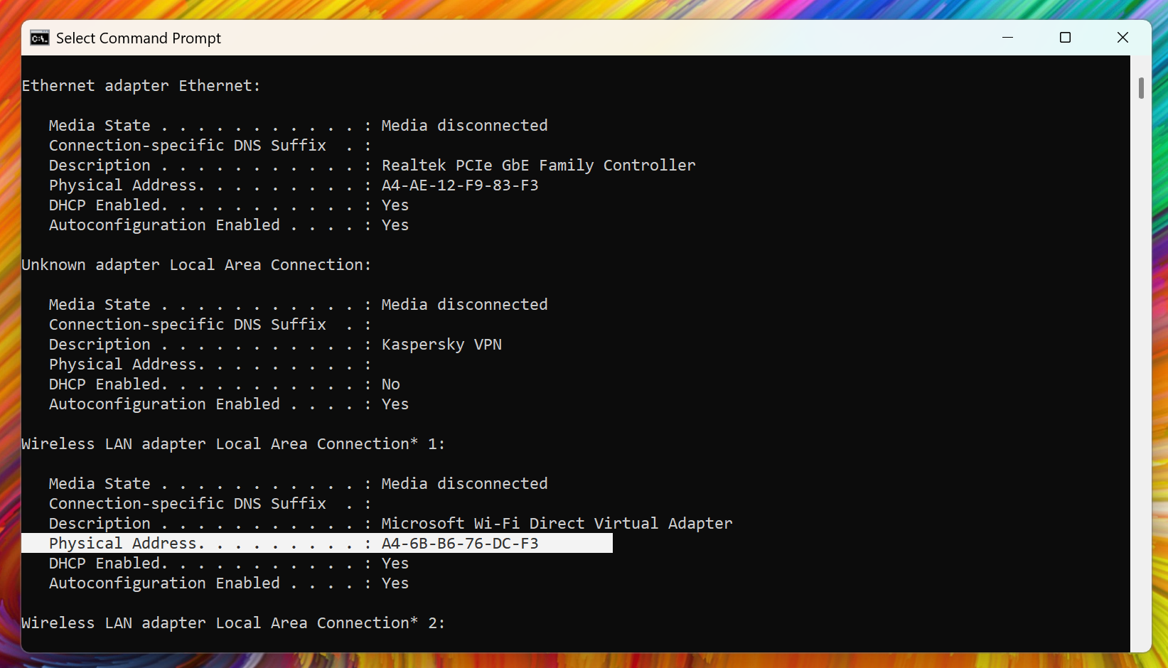
Getting Licensing for Quartus II
Now scroll down to physical address and copy the value without hyphen and save.

Slide 27
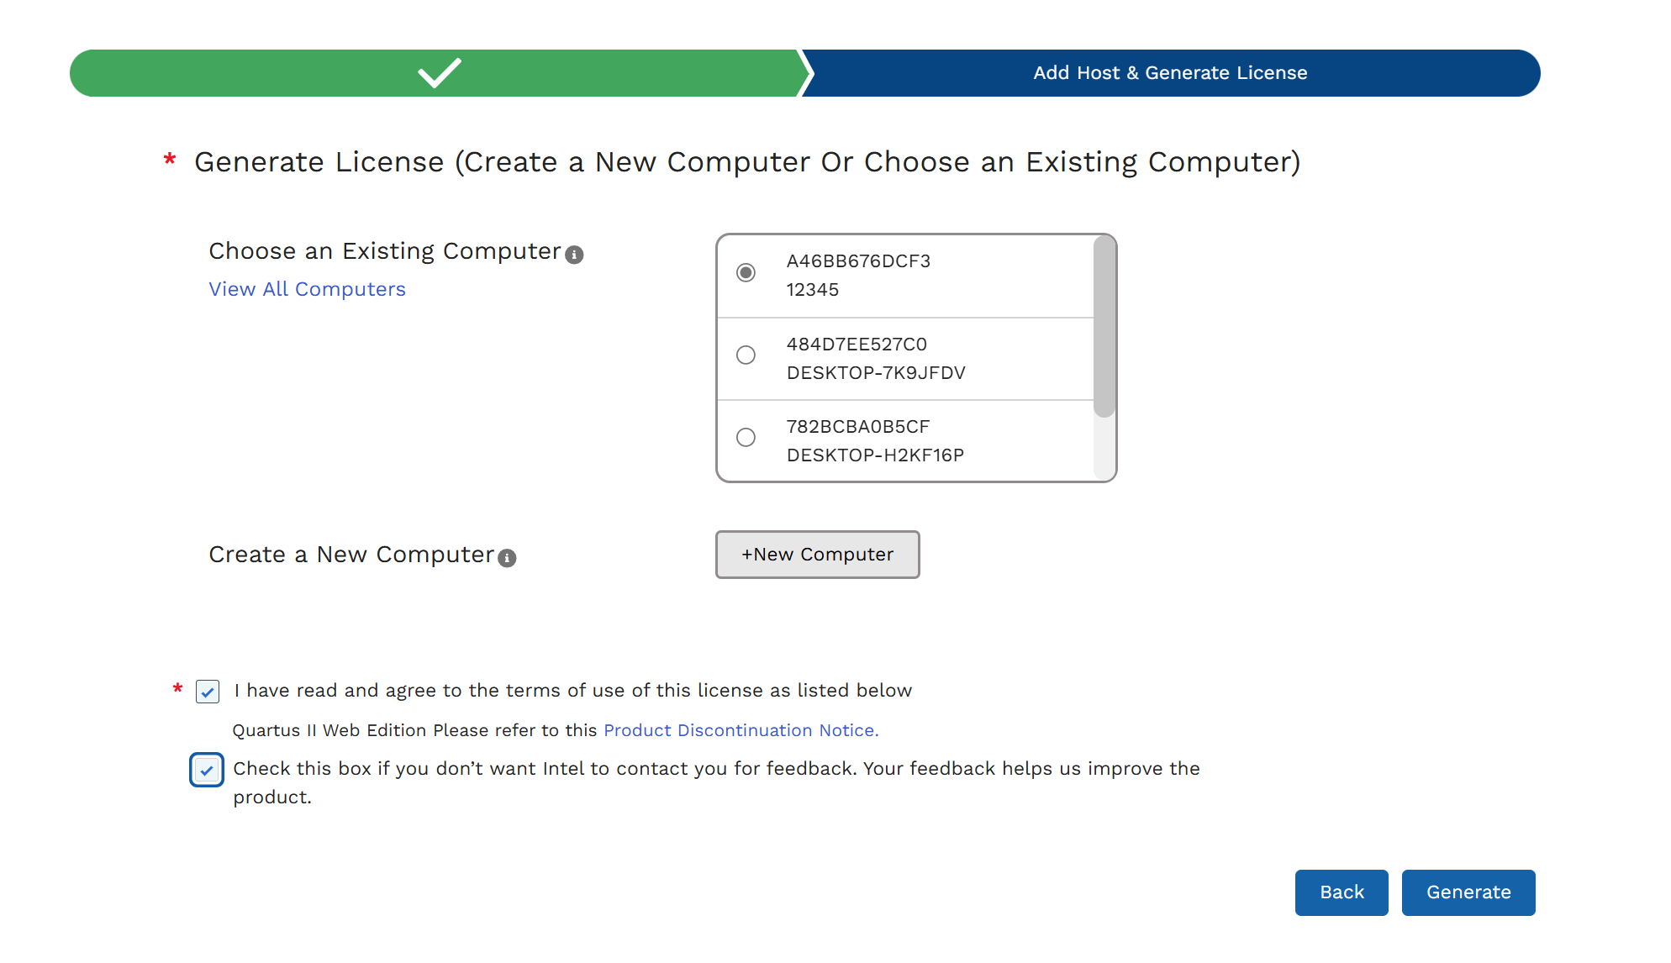
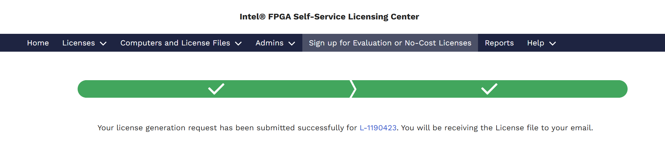
Getting Licensing for Quartus II
Now choose an existing Computer and tick mark the columns.
Now press generate.
The license file will be sent to your registered email.
Go and download.

Slide 28
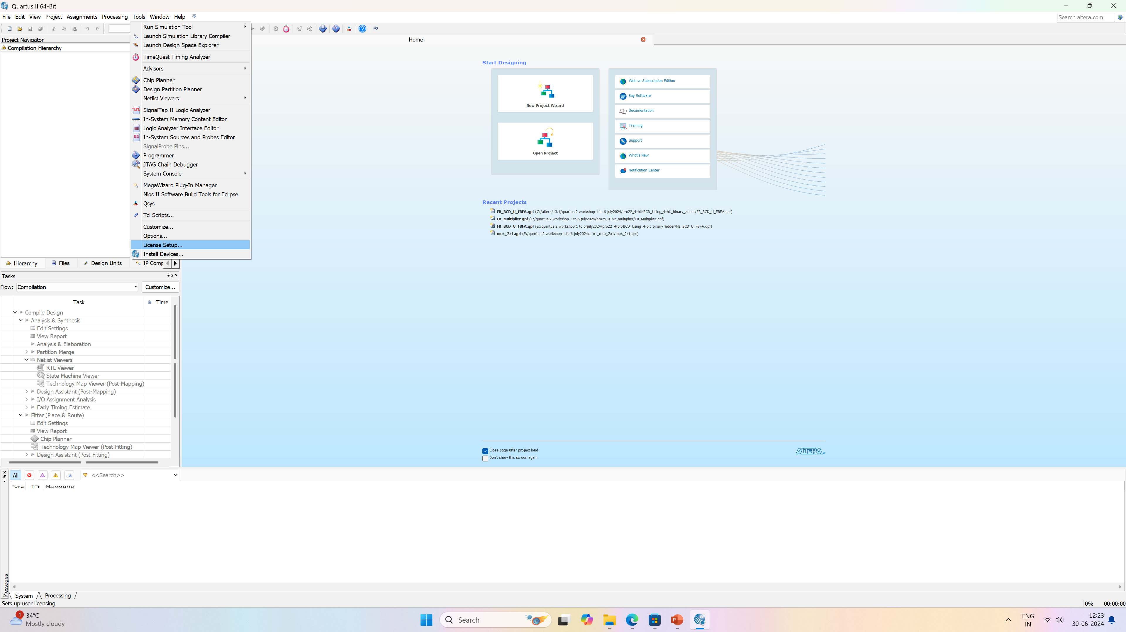
Getting Licensing for Quartus II
Now open Quartus software.
Go to tool → License setup

Slide 29
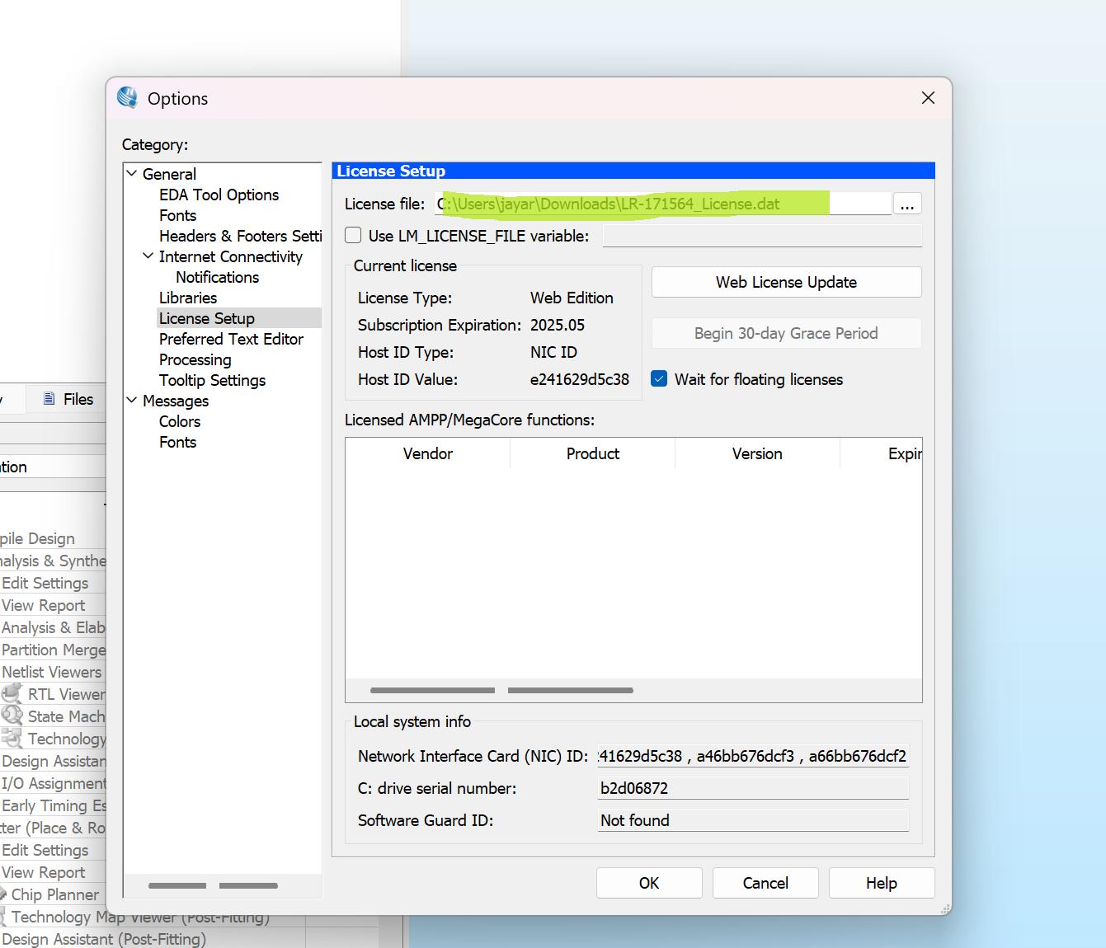
Getting Licensing for Quartus II
Now choose the license file and click ok

Slide 30
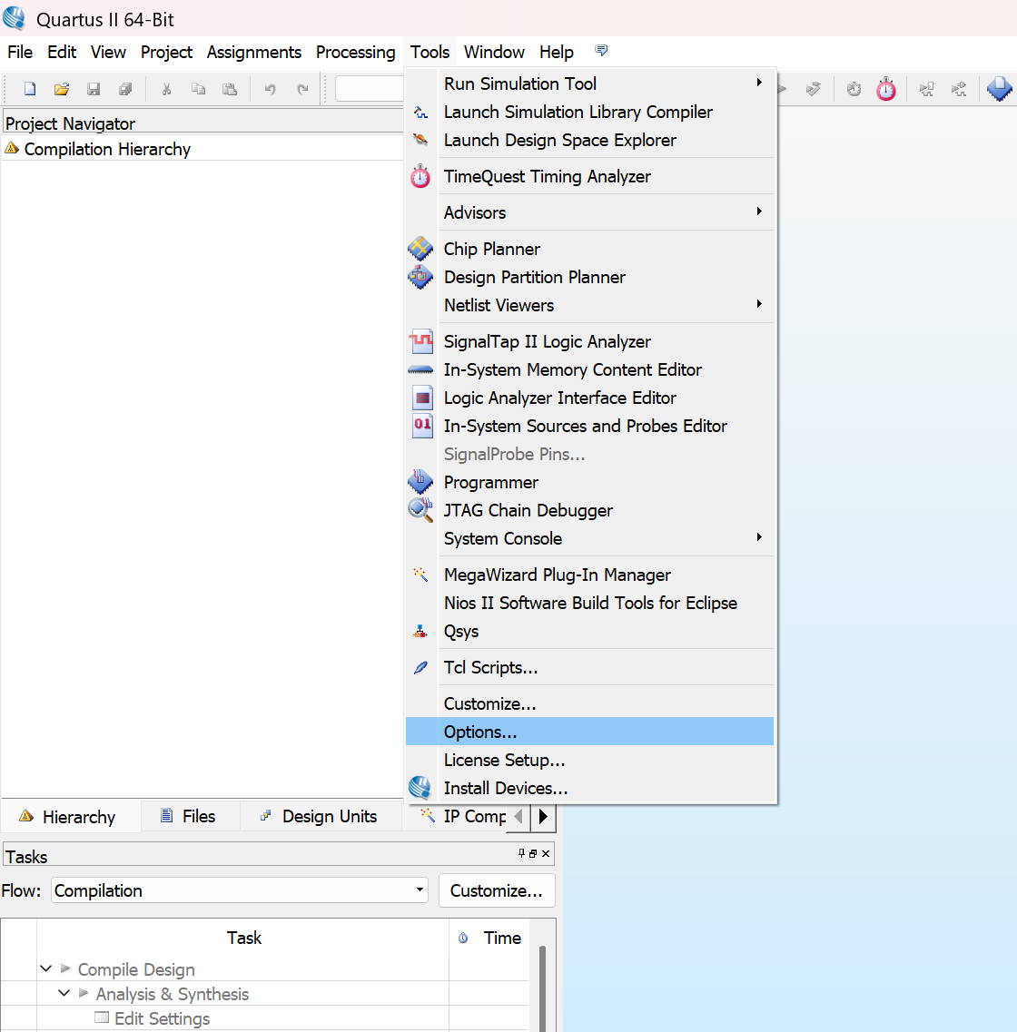
Initial setup for Quartus II
Now open Quartus II ->Select Tool->Options

Slide 31
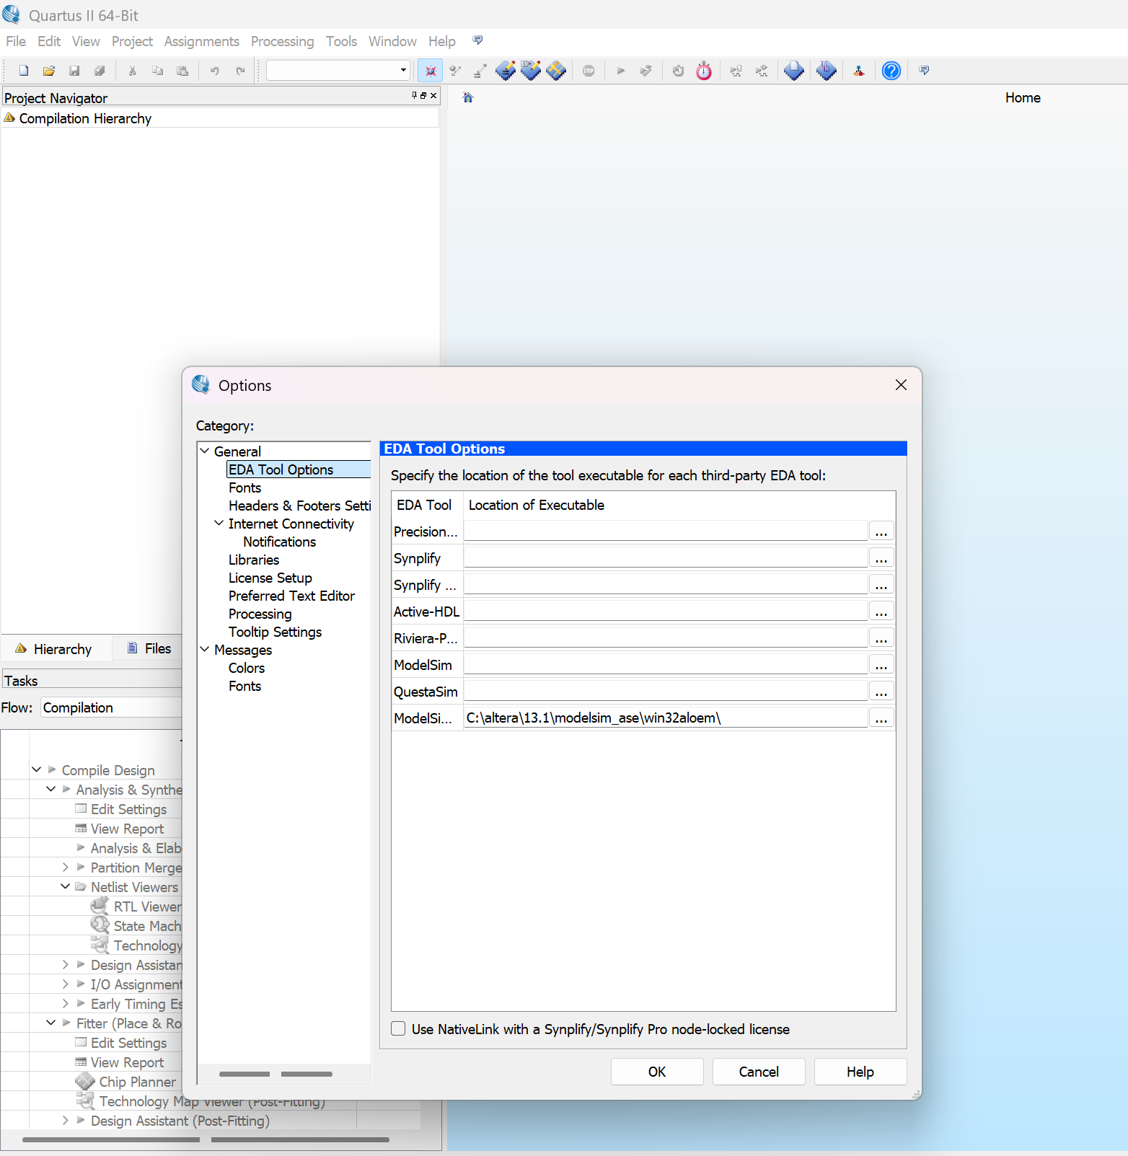
Initial setup for Quartus II
In Options-> choose EDA Tool Options and check for ModelSim path and click ok.
C:\altera\13.1\modelsim_ase\win32aloem\
You are ready to go now !

Slide 32
Verilog Programming Basics
What is Verilog?
Verilog is a HARDWARE DESCRIPTION LANGUAGE (HDL), used for describing a digital system like a network switch or a microprocessor or a memory or a flip−flop. It means, by using a HDL we can describe any digital hardware at any level. Designs, which are described in HDL are independent of technology, very easy for designing and debugging, and are normally more useful than schematics, particularly for large circuits.

Slide 33
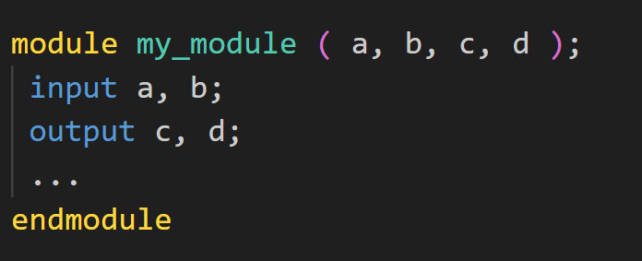
Verilog Syntax:- Module & Instantiation of Instances
A Module in Verilog is declared within the pair of keywords module and endmodule.
Following the keyword module are the module name and port interface list.
All instances must be named except the instances of primitives. i.e. and, or, nand, nor, xor, xnor, buf, not etc.

Slide 34
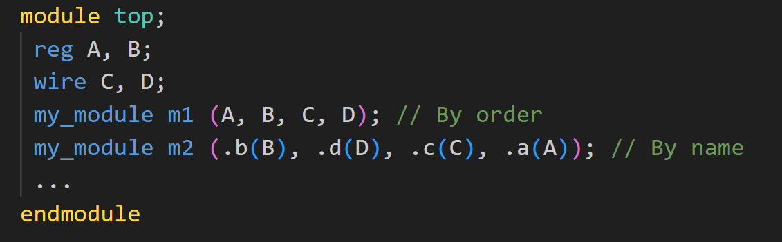
Verilog Syntax:- Module & Instantiation of Instances
In Verilog, there are 2 ways of specifying connections among ports of instances.
By ordered list (positional association):This is the more intuitive method, where the signals to be connected must appear in the module instantiation in the same order as the ports listed in module definition.
By name (named association):When there are too many ports in the large module, it becomes difficult to track the order. Connecting the signals to the ports by the port names increases readability and reduces possible errors.

Slide 35
Verilog Syntax:- Values & Literals
Verilog provides 4 basic values
0 — logic zero or false condition
1 — logic one, or true condition
x — unknown/undefined logic value. Only for physical data types.
z — high-impedance/floating state. Only for physical data types.

Slide 36
Verilog Syntax:- Values & Literals
DAY-1
Session-II
Constants in Verilog are expressed in the following format:
width 'radix value
width — Expressed in decimal integer. Optional, default is inferred from value.
'radix — Binary(b), octal(o), decimal(d), or hexadecimal(h). Optional, default is decimal.
value — Any combination of the 4 basic values can be digits for radix octal, decimal or hexadecimal
Example:- 4'b1011 // 4-bit binary of value 1011, 3'b111 // 3-bit binary of value 111, 2’b01 // 2-bit binary of value 01,1’b1 // 1-bit binary of value 1

Slide 37
Verilog Syntax:-Data Types
DAY-1
Session-II
There are 2 groups of data types in Verilog, namely physical and abstract.
Physical data type:-
Net (wire, wand, wor, tri, triand, trior). Net is the connection between ports of modules within a higher module. Default value is z. Used mainly in structural modelling.
Register (reg). Register is the storage that retains (remembers) the value last assigned to it, therefore, unlike wire, it needs not to be continuously driven. Default value is x. Used in dataflow/RTL and behavioural modelling.
Charge storage node (trireg). Default value is x. Used in gate-level and switchlevel modelings.

Slide 38
Verilog Syntax:-Data Types
DAY-1
Session-II
There are 2 groups of data types in Verilog, namely physical and abstract.
b) Abstract data type:- used only in behavioural modelling.
Integer (integer) stores 32-bit signed quantity. •
Time (time) stores 64-bit unsigned quantity from system task $time.
Real (real) stores floating-point quantity. •
Parameter (parameter) substitutes constant.
Event (event) is only name reference — does not hold value

Slide 39
Verilog Syntax:- Vectors & Arrays
DAY-1
Session-II
Physical data types (wire, reg, trireg) can be declared as vector/bus (multiple bit widths). An Array is a chunk of consecutive values of the same type.
Data types reg, integer and time can be declared as an array.
Example:-
wire [3:0] data; // 4-bit wide vector
reg bit [1:8]; // array of 8 1-bit scalar
reg [3:0] mem [1:8]; // array of 8 4-bit vector

Slide 40
Verilog Syntax:- Operators
DAY-1
Session-II
Verilog Bit Wise Operators
Operator | Description
~ | bit-wise NOT
& | bit-wise AND
~& | bit-wise NAND
| | bit-wise OR
~| | bit-wise NOR
^ | bit-wise XOR
~^ | bit-wise XNOR
Verilog Arithmetic Operators
Operator | Description
+ | addition
- | subtraction
* | multiplication
/ | division
% | modulus
** | Exponential operator (introduced in Verilog 2001)
Verilog Relational Operators
Operator | Description
> | greater than
>= | greater than or equal to
< | less than
<= | less than or equal to
== | is equal to
!= | is not equal to

Slide 41
Verilog Syntax:- Operators
DAY-1
Session-II
Verilog Logical Operators
Operator | Description
&& | logical AND
|| | logical OR
! | logical NOT
Verilog Shift Operators
Operator | Description
<< | shift left logical
>> | shift right logical
<<< | shift left arithmetic (introduced in verilog 2001)
>>> | shift right arithmetic (introduced in verilog 2001)
Verilog Concatenation Operator
Operator | Description
{ } | Concatenation operator
{{ }} | Replication operator
Verilog Conditional Operator:- output = <condition> ? <true> : <false>

Slide 42
Verilog Syntax:- Structured Procedures
DAY-1
Session-II
There are 2 structured procedure statements, namely initial and always.
They are the basic statements for behavioral modeling from which other behavioral statements are declared.
They cannot be nested, but many of them can be declared within a module.
a) initial statement:- initial statement executes exactly once and becomes inactive upon exhaustion. If there are multiple initial statements, they all start to execute concurrently at time 0.
b) always statement:- always statement continuously repeats itself throughout the simulation. If there are multiple always statements, they all start to execute concurrently at time 0. always statements may be triggered by events using an event recognizing list @( ).

Slide 43
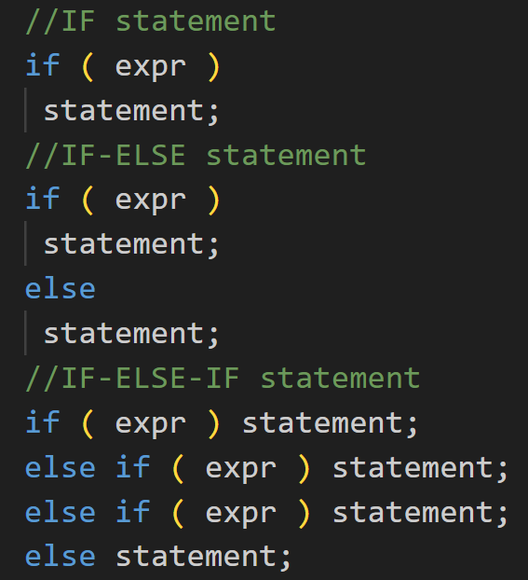
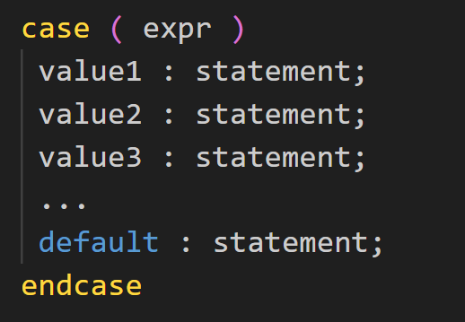
Verilog Syntax:-Conditional Statements
DAY-1
Session-II
The body only allows a single statement. If multiple statements are desired, block statements may be used to enclose multiple statements in place of the body.
If-Then-Else:-
b) Case:-

Slide 44
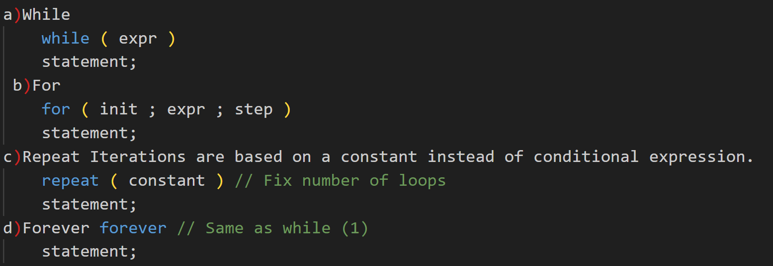
Verilog Syntax:- Loop Statements
DAY-1
Session-II
The body only allows a single statement. If multiple statements are desired, block statements may be used to enclose multiple statements in place of the body.

Slide 45
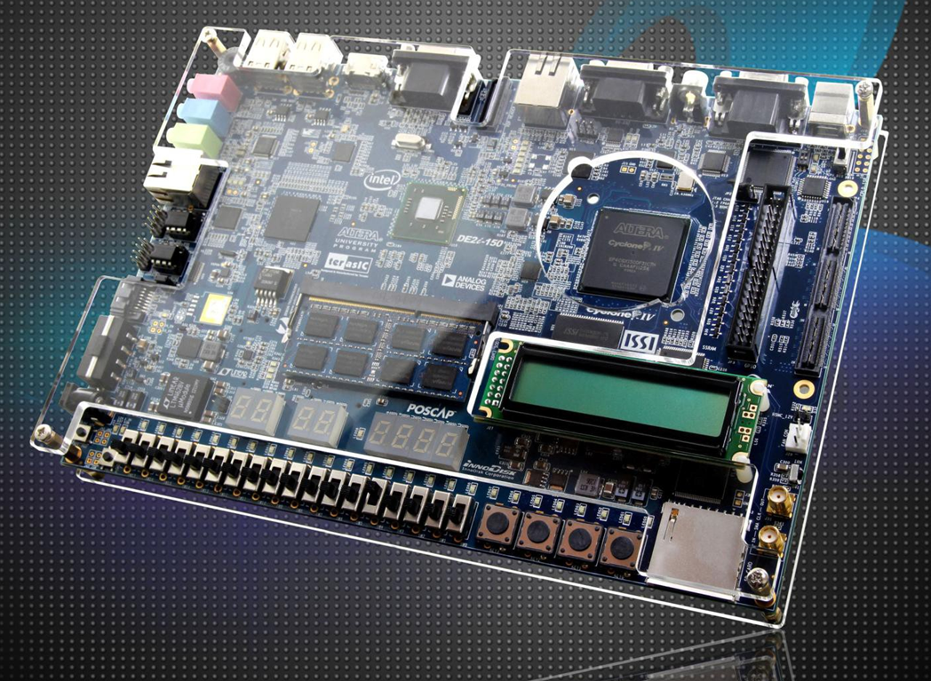
DE2i-150 Board

Slide 46
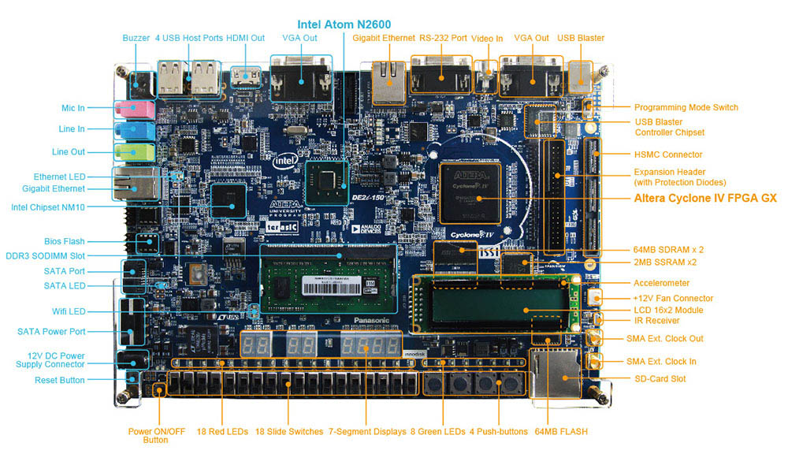
Layout and Components

Slide 47
Components required for workshop
The following hardware (FPGA System) is of our consideration on the DE2i-150 board:
Altera Cyclone® IV 4CX150 FPGA device(Cyclone IV EP4CGX150DF31C7)
USB Blaster (on board) for programming
4 Push-buttons
18 Slide switches
18 Red user LEDs
9 Green user LEDs
8 7-Segment Displays
50MHz oscillator for clock sources

Slide 48
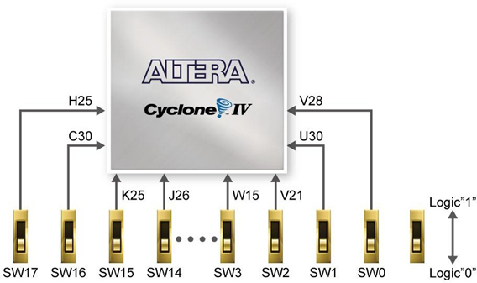
Using Switches on the DE2i-150 board
Signal Name | FPGA Pin No. | Description | I/O Standard
SW[0] | PIN_V28 | Slide Switch[0] | 2.5V
SW[1] | PIN_U30 | Slide Switch[1] | 2.5V
SW[2] | PIN_V21 | Slide Switch[2] | 2.5V
SW[3] | PIN_C2 | Slide Switch[3] | 2.5V
SW[4] | PIN_AB30 | Slide Switch[4] | 2.5V
SW[5] | PIN_U21 | Slide Switch[5] | 2.5V
SW[6] | PIN_T28 | Slide Switch[6] | 2.5V
SW[7] | PIN_R30 | Slide Switch[7] | 2.5V
SW[8] | PIN_P30 | Slide Switch[8] | 2.5V
SW[9] | PIN_R29 | Slide Switch[9] | 2.5V
SW[10] | PIN_R26 | Slide Switch[10] | 2.5V
SW[11] | PIN_N26 | Slide Switch[11] | 2.5V
SW[12] | PIN_M26 | Slide Switch[12] | 2.5V
SW[13] | PIN_N25 | Slide Switch[13] | 2.5V
SW[14] | PIN_J26 | Slide Switch[14] | 2.5V
SW[15] | PIN_K25 | Slide Switch[15] | 2.5V
SW[16] | PIN_C30 | Slide Switch[16] | 2.5V
SW[17] | PIN_H25 | Slide Switch[17] | 2.5V

Slide 49
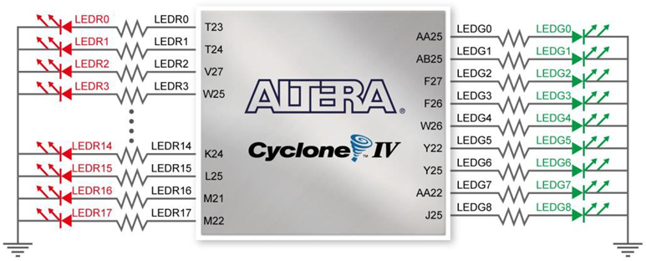
Using LEDs on the DE2i-150 board
Signal Name | FPGA Pin No. | Description | I/O Standard
LEDR[0] | PIN_T23 | LED Red[0] | 2.5V
LEDR[1] | PIN_T24 | LED Red[1] | 2.5V
LEDR[2] | PIN_V27 | LED Red[2] | 2.5V
LEDR[3] | PIN_W25 | LED Red[3] | 2.5V
LEDR[4] | PIN_T21 | LED Red[4] | 2.5V
LEDR[5] | PIN_T26 | LED Red[5] | 2.5V
LEDR[6] | PIN_R25 | LED Red[6] | 2.5V
LEDR[7] | PIN_T27 | LED Red[7] | 2.5V
LEDR[8] | PIN_P25 | LED Red[8] | 2.5V
LEDR[9] | PIN_R24 | LED Red[9] | 2.5V
LEDR[10] | PIN_P21 | LED Red[10] | 2.5V
LEDR[11] | PIN_N24 | LED Red[11] | 2.5V
LEDR[12] | PIN_N21 | LED Red[12] | 2.5V
LEDR[13] | PIN_M25 | LED Red[13] | 2.5V
LEDR[14] | PIN_K24 | LED Red[14] | 2.5V
LEDR[15] | PIN_L25 | LED Red[15] | 2.5V
LEDR[16] | PIN_M21 | LED Red[16] | 2.5V
LEDR[17] | PIN_M22 | LED Red[17] | 2.5V
LEDG[0] | PIN_AA25 | LED Green[0] | 2.5V
LEDG[1] | PIN_AB25 | LED Green[1] | 2.5V
LEDG[2] | PIN_F27 | LED Green[2] | 2.5V
LEDG[3] | PIN_F26 | LED Green[3] | 2.5V
LEDG[4] | PIN_W26 | LED Green[4] | 2.5V
LEDG[5] | PIN_Y22 | LED Green[5] | 2.5V
LEDG[6] | PIN_Y25 | LED Green[6] | 2.5V
LEDG[7] | PIN_AA22 | LED Green[7] | 2.5V
LEDG[8] | PIN_J25 | LED Green[8] | 2.5V

Slide 50
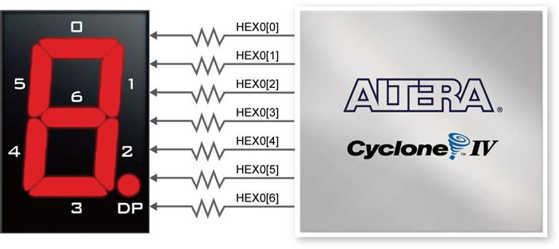
Using the 7-segment Displays on the DE2i-150 board
Signal Name | FPGA Pin No. | Description | I/O Standard
HEX0[0] | PIN_E15 | Seven Segment Digit 0[0] | 2.5V
HEX0[1] | PIN_E12 | Seven Segment Digit 0[1] | 2.5V
HEX0[2] | PIN_G11 | Seven Segment Digit 0[2] | 2.5V
HEX0[3] | PIN_F11 | Seven Segment Digit 0[3] | 2.5V
HEX0[4] | PIN_F16 | Seven Segment Digit 0[4] | 2.5V
HEX0[5] | PIN_D16 | Seven Segment Digit 0[5] | 2.5V
HEX0[6] | PIN_F14 | Seven Segment Digit 0[6] | 2.5V
HEX1[0] | PIN_G14 | Seven Segment Digit 1[0] | 2.5V
HEX1[1] | PIN_B13 | Seven Segment Digit 1[1] | 2.5V
HEX1[2] | PIN_G13 | Seven Segment Digit 1[2] | 2.5V
HEX1[3] | PIN_F12 | Seven Segment Digit 1[3] | 2.5V
HEX1[4] | PIN_G12 | Seven Segment Digit 1[4] | 2.5V
HEX1[5] | PIN_J9 | Seven Segment Digit 1[5] | 2.5V
HEX1[6] | PIN_G10 | Seven Segment Digit 1[6] | 2.5V
HEX2[0] | PIN_G8 | Seven Segment Digit 2[0] | 2.5V
HEX2[1] | PIN_G7 | Seven Segment Digit 2[1] | 2.5V
HEX2[2] | PIN_F7 | Seven Segment Digit 2[2] | 2.5V
HEX2[3] | PIN_AG30 | Seven Segment Digit 2[3] | 2.5V
HEX2[4] | PIN_F6 | Seven Segment Digit 2[4] | 2.5V
HEX2[5] | PIN_F4 | Seven Segment Digit 2[5] | 2.5V
HEX2[6] | PIN_F10 | Seven Segment Digit 2[6] | 2.5V

Slide 51
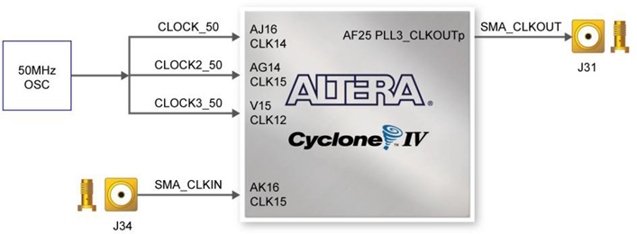
Clock Circuitry on the DE2i-150 board
Signal Name | FPGA Pin No. | Description | I/O Standard
CLOCK_50 | PIN_AJ16 | 50 MHz clock input | 3.3V
CLOCK2_50 | PIN_A15 | 50 MHz clock input | 3.3V
CLOCK3_50 | PIN_V15 | 50 MHz clock input | 2.5V
SMA_CLKOUT | PIN_AF25 | External (SMA) clock output | 3.3V
SMA_CLKIN | PIN_AK16 | External (SMA) clock input | 3.3V

Slide 52
Thank You
Lets Get Started………

